Slide 1
Post-weaning diarrhea I
MENU
ANALYSIS
CONTACT
Biomedical StatisticsS
BMD407: Biomedical Statistics
Under Supervision of:
Dr. Mohamed Maysara
Eng. Mariam Oweda

Slide 2
Team Members
Shrouk Hesham
Omar Khaled
Mohaned Atef
Reham Galal
Beshoy Reda

Slide 3
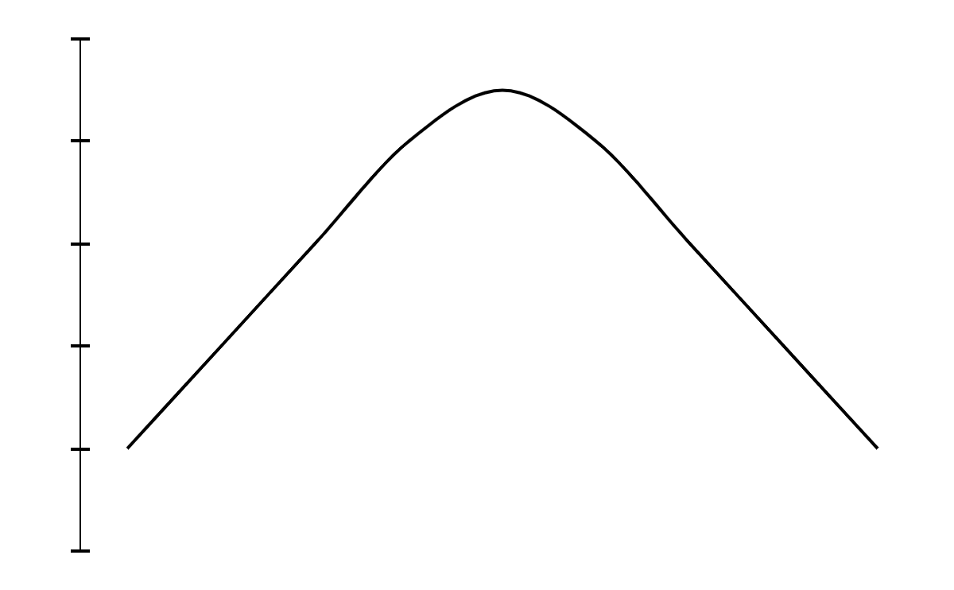
Introduction
Post-weaning diarrhea (PWD) is a worldwide economically important disease in pigs in piggeries.
The disease is characterized by increased mortality, weight loss, retarded growth, increased costs, and higher use of antibiotics
Enterotoxigenic Escherichia coli is the most important cause of the disease

Slide 4
Data reading
We read the data by importing it into R, then proceeding it. Nine columns were identified, and they are as following:
35%
10%
65%
• ADWG0021 (average daily weight gain (g/day) in the period between 0 and 21 days post-weaning)
• ADWG2150 (between day 21 and day 50 post-weaning)
• ADWG0050 (period between 0 and 50 days post-weaning)
• Pen (number of pens which contain 16 piglets in one pen)
• Treatment (contain 5 treatments (A, B, C,D,E), each treatment group consists of 128 piglets (thus 8 pens of 16 piglets))
• Feeder (food)
• Sex (male, female)
• W0 (weight)
• P0 (number of piglets in each pen)

Slide 5
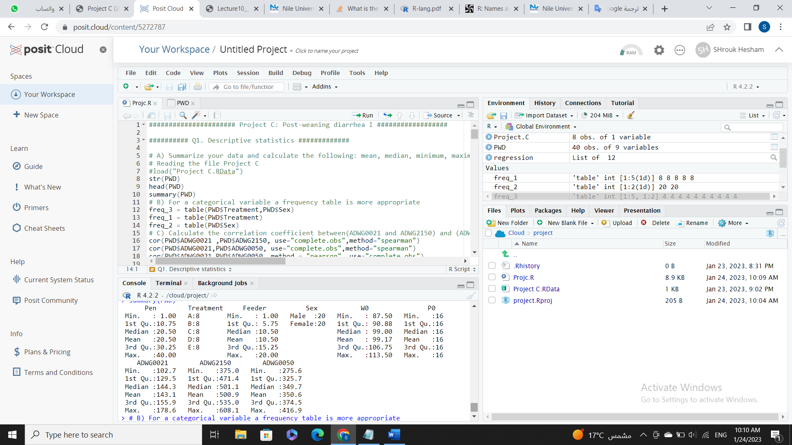
Descriptive Statistics
20%
40%
60%
80%

Slide 6
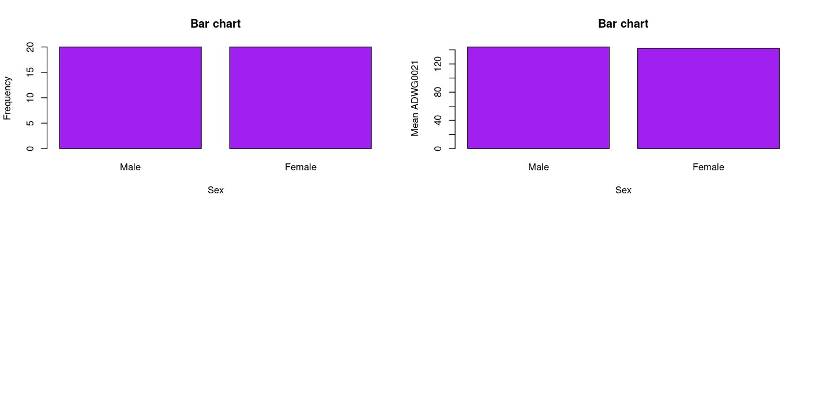
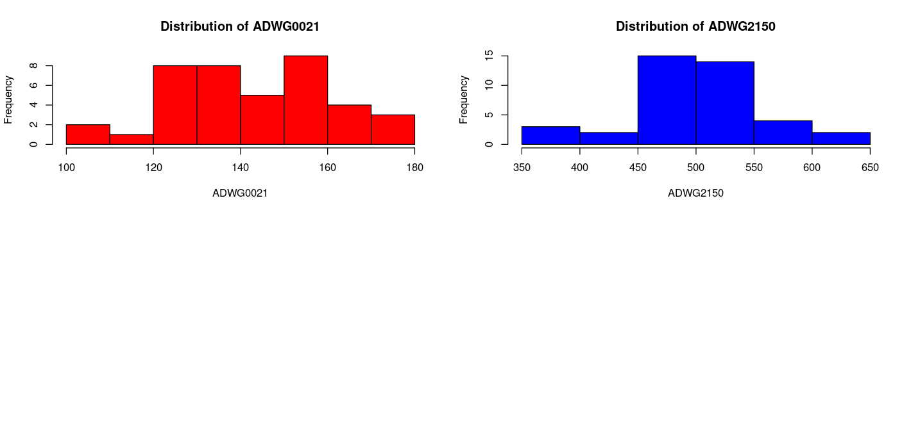
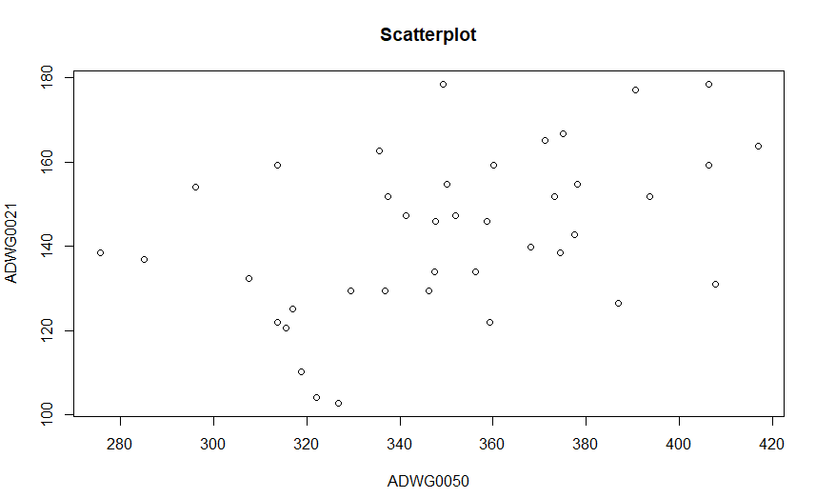
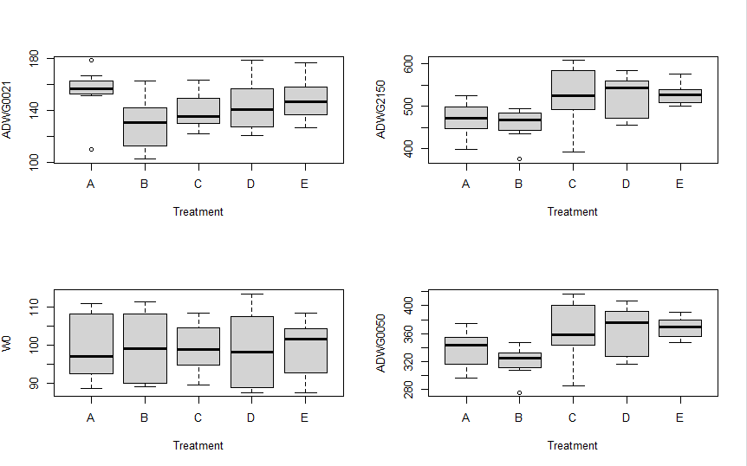
Graphs
histogram visualization of continuous variable: “ADWG2150” as well as “ADWG0021
males and females have the different mean, 144.07 and 142.15 respectively
Scatterplot show the Distribution between the points for ADWG0021 and ADWG0050
shows boxplot visualization (ADWG0021,ADWG0050,ADWG2150) and a separate boxplots per Treatment

Slide 7
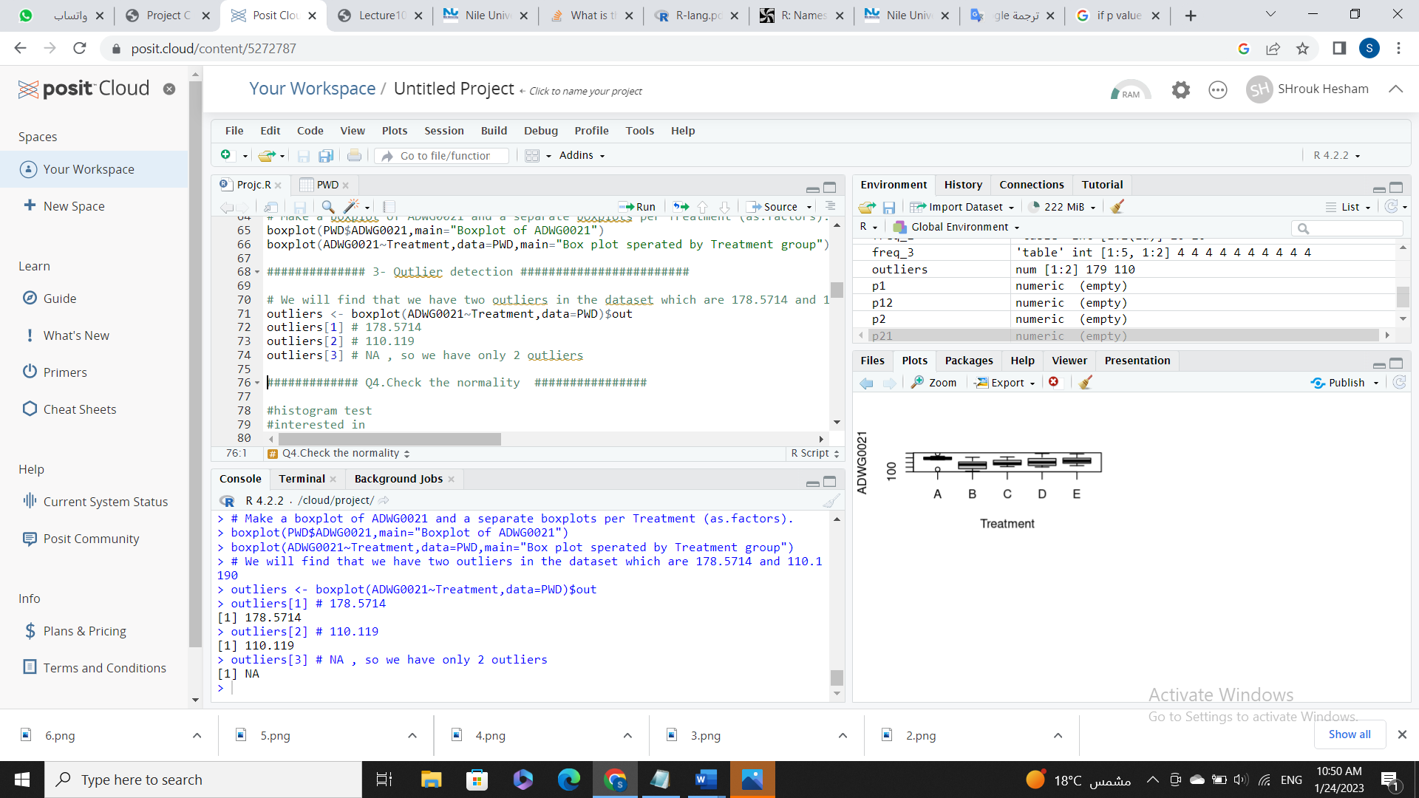
3. Outliers Detection
They're unusual values in a dataset.
Outlier 1 is 178.5714, outlier 2 is 110.119 and outlier 3 is NA.
Having low outliers is a good indicator about our data
So, we have only 2 outliers.

Slide 8
Normality
Data mainly fall under two assumptions, which are Normal distribution and random sampling
We used 2 methods to check normality, Shapiro and QQ-plot
According to Shapiro’s test for checking the normality the values gives for ADWG0021, ADWG2150, ADWG0050 are 0.7305, 0.9086, 0.9037 respectively

Slide 9
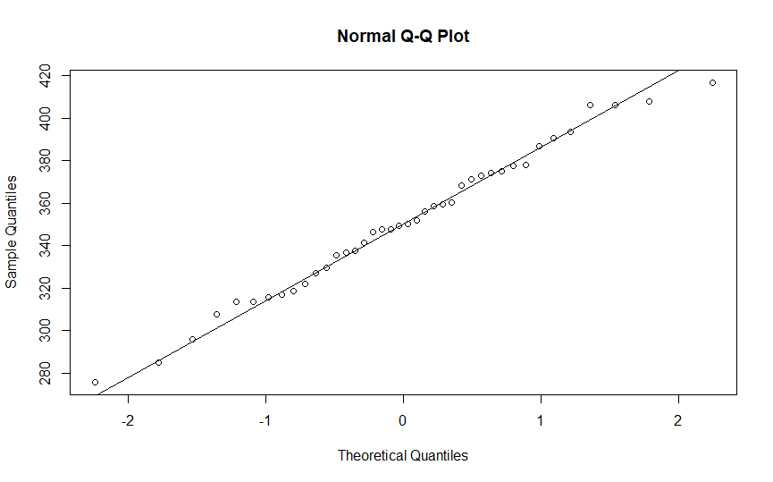
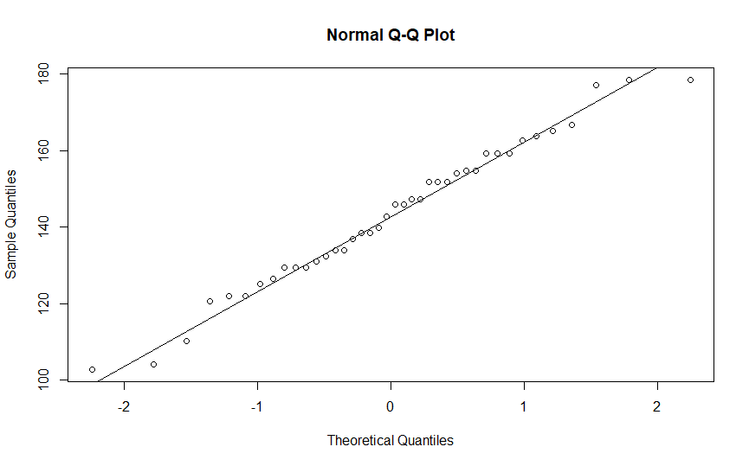
Normality
Comparing to the alpha value (0.05), these values assume the normality of the data
The second method is the QQ-plot which supported the Shapiro’s test results assuming normality as shown in below figures as an example

Slide 10
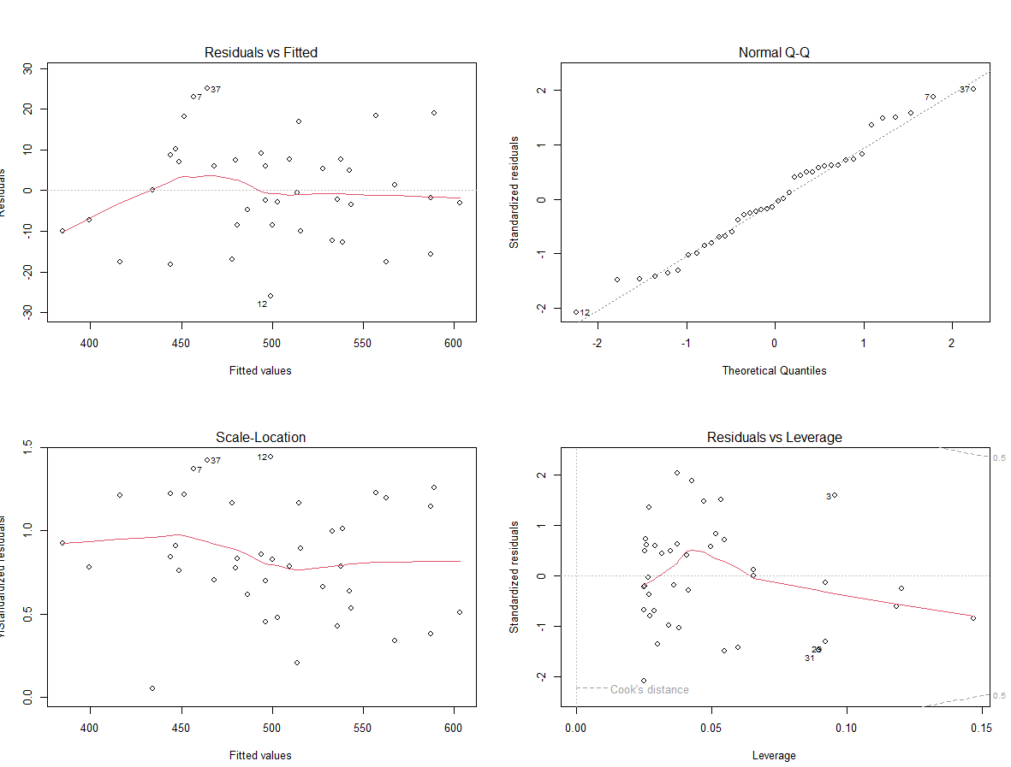
Homo/Heteroscedasticity
Homoscedasticity is present when the variance of the residuals is observed to be uneven. However, we tested the variance using 3 methods: Boxplot, Bartlett’s test and Levene’s test
they showed variation in the data.
Homoscedasticity was observed

Slide 11
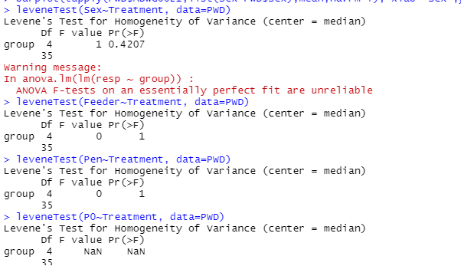
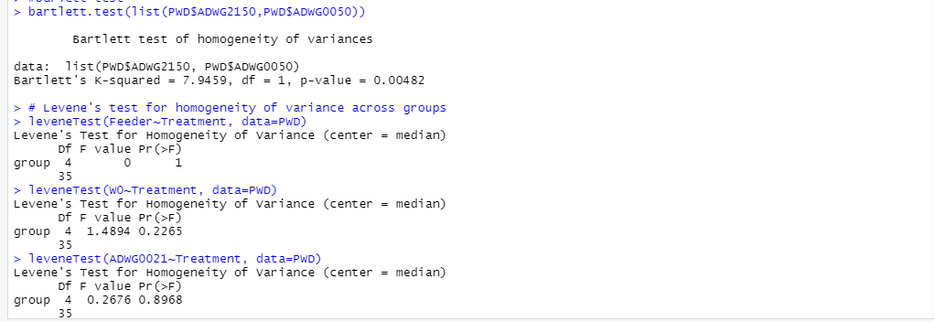
Homo/Heteroscedasticity
Levene’s test
Barlett’s test
Boxplot

Slide 12
Confidence Intervel
A confidence interval is the mean of estimate plus and minus the variation in that estimate.
We Calculated the 90%, 95%, 99% confidence interval for the means of ADWG0021per each gender
The 90 and 95 % confidence intervals are narrow comparing to 99% confidence interval.
90%
95%
95%
138.0131-148.2121
136.9906-149.2346
134.9167-151.3085

Slide 13
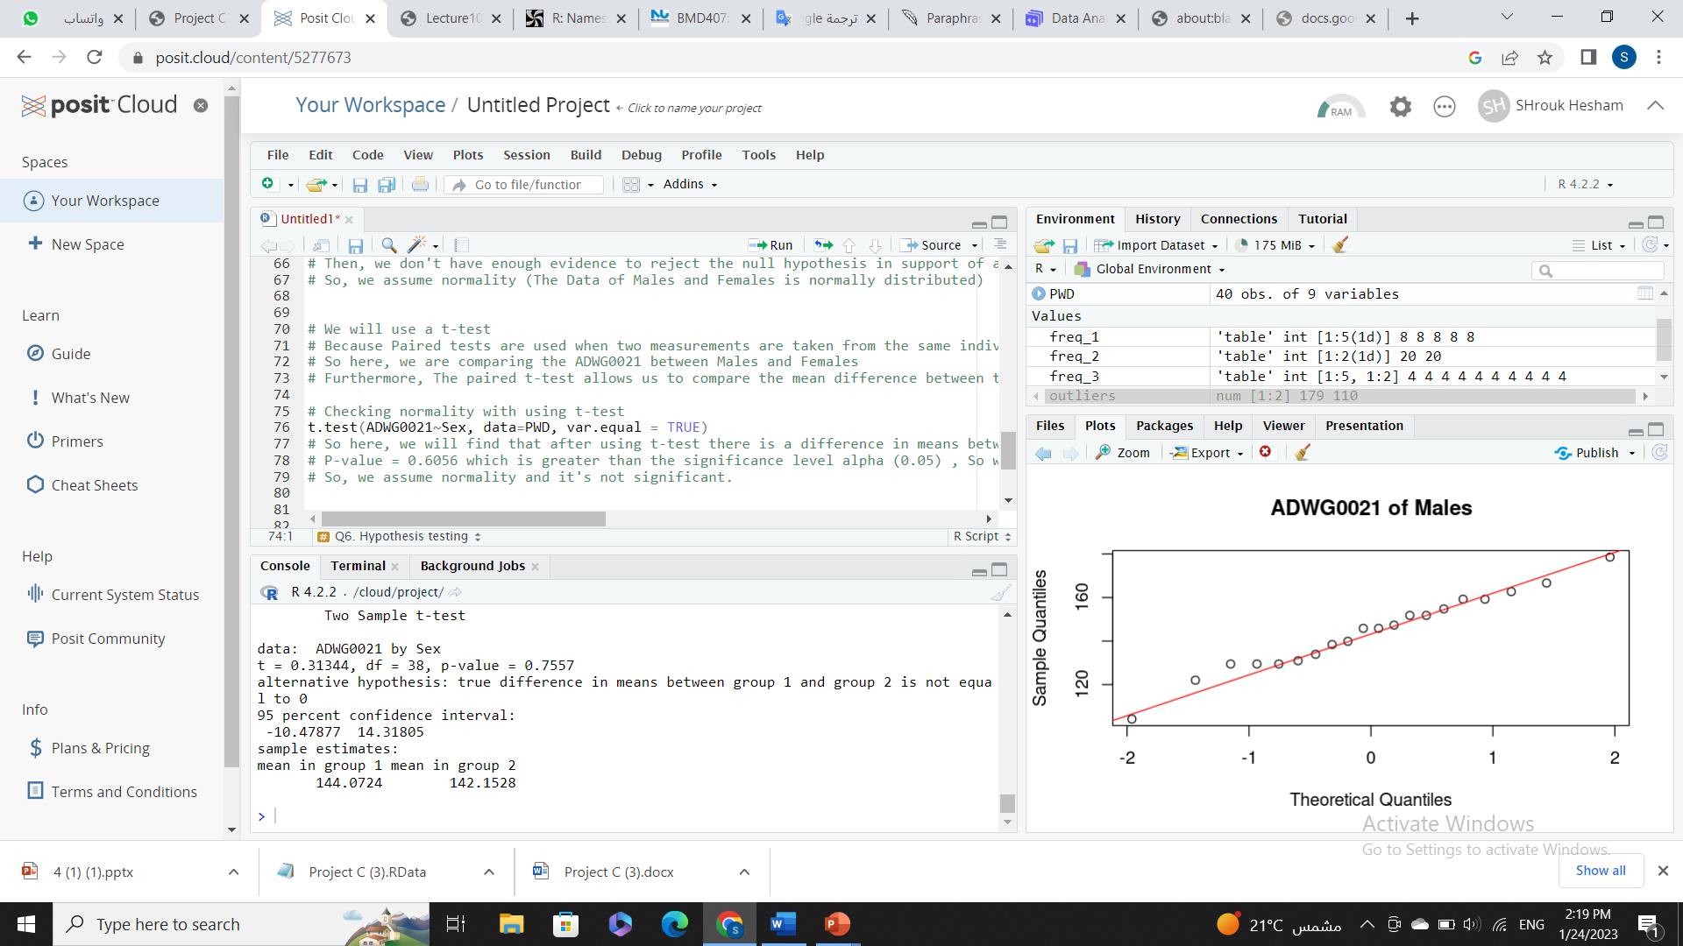
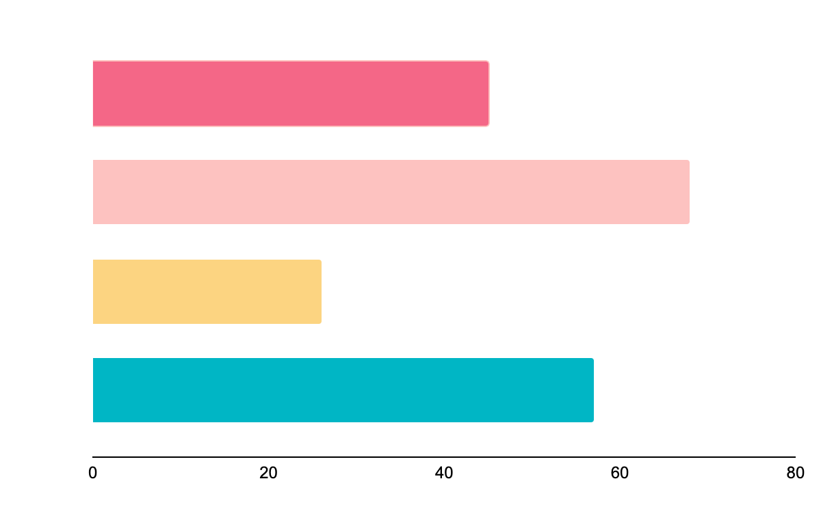
6. Hypothesis testing
Assuming normality and homoscedasticity
We will use a t‐test, Because Paired tests are used when two measurements are taken from the same individual (say, person)
So here, we are comparing the ADWG0021 between Males and Females
we will find that after using t-test there is a difference in means between Male and Female in ADWG0021 as P-value = 0.7557 which is greater than alpha
Follow the link in the graph to modify its data and then paste the new one here. For more info, click here

Slide 14
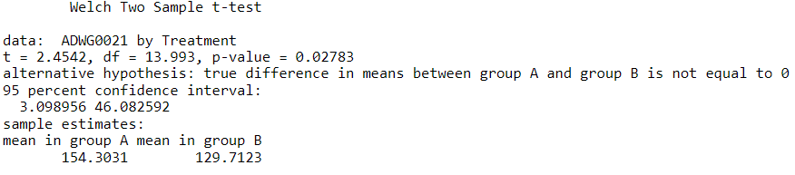
6.2 Hypothesis testing
By applying welch t-test we will find that the p-value = 0.02783 which is smaller than alpha = .05
We have enough evidence to reject null which means that ADWG0021 is different in the group receiving Treatment A (normal feed + ZnO) compared to the Treatment B (normal feed + nutraceuticals)

Slide 15
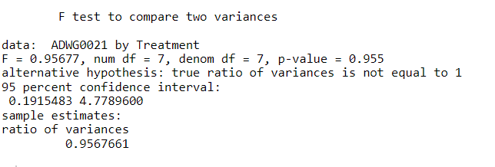
6.2 Hypothesis testing
variance
Null: data is equal in variance
Alternative Hypothesis: data is not equal in variance
By using var.test we will find that p-value = 0.955 > .05.
We don’t have enough evidence to reject null. That data is homoscedastic.

Slide 16
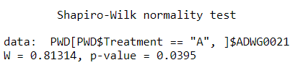
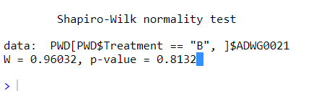
6.2 Hypothesis testing
Normality
Null: data is normally distributed
Alternative Hypothesis: not normally distributed
group A , p-value Null: data is normally distributed
Alternative Hypothesis:
= 0.0395 < .05,
so we have enough evidence to reject null
Group A is not normally distributed.
group B, p-value = 0.8132 > .05,
so we don’t have enough evidence to reject null
group B is normally distributed.

Slide 17
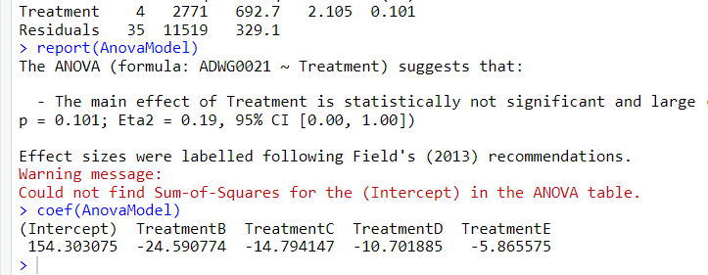
6.3 Hypothesis testing
p = 0.101> .05,
we don’t have enough evidence to reject null. There is difference between groups.
Then we use TukeyHSD(anova) to compare all groups.

Slide 18
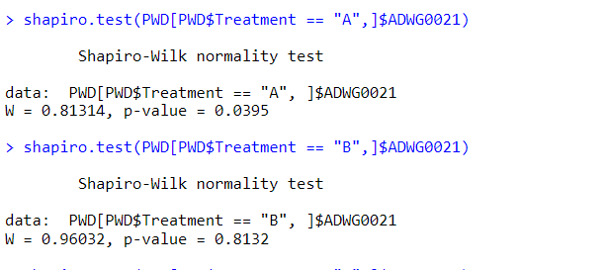
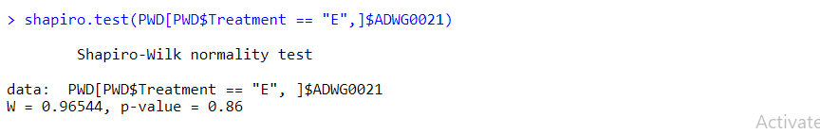
6.3 Hypothesis testing
Normality
we will find that all groups are normally disributed except A

Slide 19
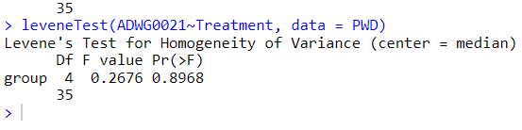
6.3 Hypothesis testing
variance
Null: data is equal in variance
Alternative Hypothesis: data is not equal in variance
P-value>.05
we don't have enough evidence to reject null
Treatment is equal variance.
data is homoscedasticity.

Slide 20
Linear Model
S
Two linear models were created
Sex and Treatment were used as regressors respectively.
Treatment column was encoded using one-hot encoding because:
It allows the model to receive it as an input
It allows each treatment category to have its own weight
T

Slide 21
Results - Sex
Model had intercept of 145.992
slope of -1.920
RSE = 19.37
R2 = 0.002579
F-stat = 0.09824,
p-value = 0.7557
Model in ineffective and statistically insignificant
S

Slide 22
Results - Sex
average change per unit for Rsex is -1.920, to further demonstrate:
Dummy data was generated for both male and female.
As expected, model can only output 2 constant values based on sex
constant prediction when male: 144.0724, prediction when female: 142.1528
144.072 - 142.1528 = 1.9196
S

Slide 23
Results - Sex
S
-14.31805
10.47877
95%
This means that Intercept + (-14.31805 – 10.47877) has 95% chance of containing true value

Slide 24
Results - Comparison
S
T
Variables | ModelS | ModelT
RSE | 19.37 | 18.14
Intercept | 145.992 | 154.303
Slope | -1.920 | -24.591 -14.794 -10.702 -5.866
R2 | 0.002579 | 0.1939
F-stat/p-value | 0.09824 / 0.7557 | 2.105/0.1011

Slide 25
THANKS
MENU
ANALYSIS
CONTACT
Data ANALYSIS
Do you have any questions?
youremail@freepik.com
+91 620 421 838
yourcompany.com
Please keep this slide for attribution

